Slide 1


Concrete Strength Analysis
Uzman Qaisar

Slide 2


About the data
Over 1,000 cement samples…
… measured in 8 key features …
… for Compressive Strength.
Data graciously provided by
Prof. I-Cheng Yeh Department of Information Management Chung-Hua University

Slide 3
Data and Script
The script for this project was written by the author, Uzman Qaisar, and is accessible here:
https://github.com/Toissincera/ConcreteAnalysis/blob/main/Cement_2.py
(Change dataset directory with the one provided below)
Dataset used accessible here:
https://github.com/Toissincera/ConcreteAnalysis/blob/main/CONCRETEDATA.csv

Slide 4
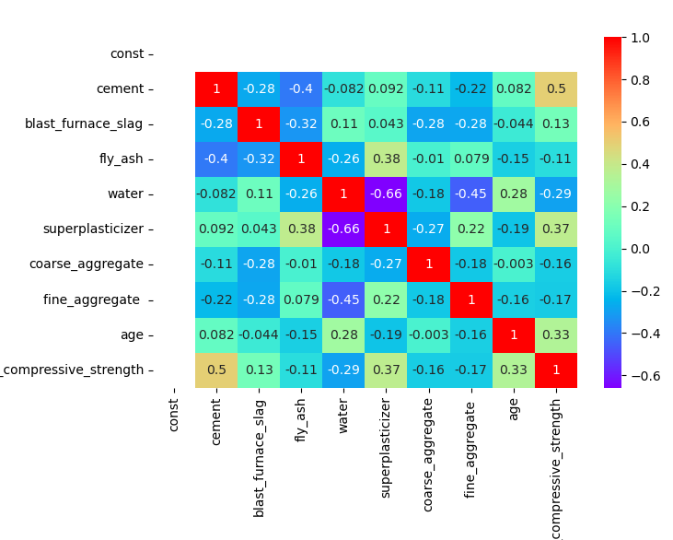
Appendix One
Strong inverse proportionality noted between superplasticizer & water, and fine aggregate & water.
Superplasticizers help synthesize concrete with around 15% less water.
Fine aggregates fill the gaps water may have left, creating robust concrete suited for humid conditions.
Neither three may be removed, because superplasticizers are a far too important sister industry to concrete, whilst fine aggregates are mandated reporting by ICLG for maintenance operations and disaster management. Water itself has a high P-Value.
Not to mention, with only 8 features, feature extraction is information torching.

Slide 5
Appendix Two
Comparably worse but competitive goodness-of-fit was observed in two other model types. We are ignoring them for clients’ simplicity’s sake. They still have post-optimization worse scores.
Secondly, only R² Scores gauged models, although other methods (see Appendix 3) may be used as sanity check.

Slide 6
Appendix Three
Mean Absolute Percentage Error was fantastic throughout the process for this method. Fully optimized for MAPE, we brought it down to 0.1%.
While Mean Absolute Error may seem excessive, consideration was given to break cycles, which, simply put, categorize concrete in ranges. I optimized for a feasibly category.

Slide 7
Bibliography
Special thanks to my sister, Zainab Alam, a seasoned architect, for her architectural domain knowledge. Thanks also to Shadman Qaisar, my brother, for his ML domain knowledge.
Minor references derived from publicly available civil & architecture regulatory institutes. Analysis optimized for use in USA, not India.

